Slide 1
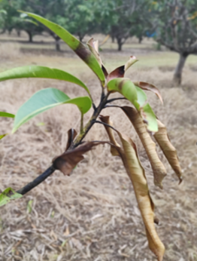
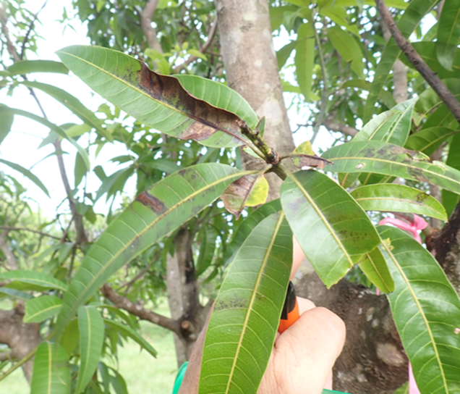
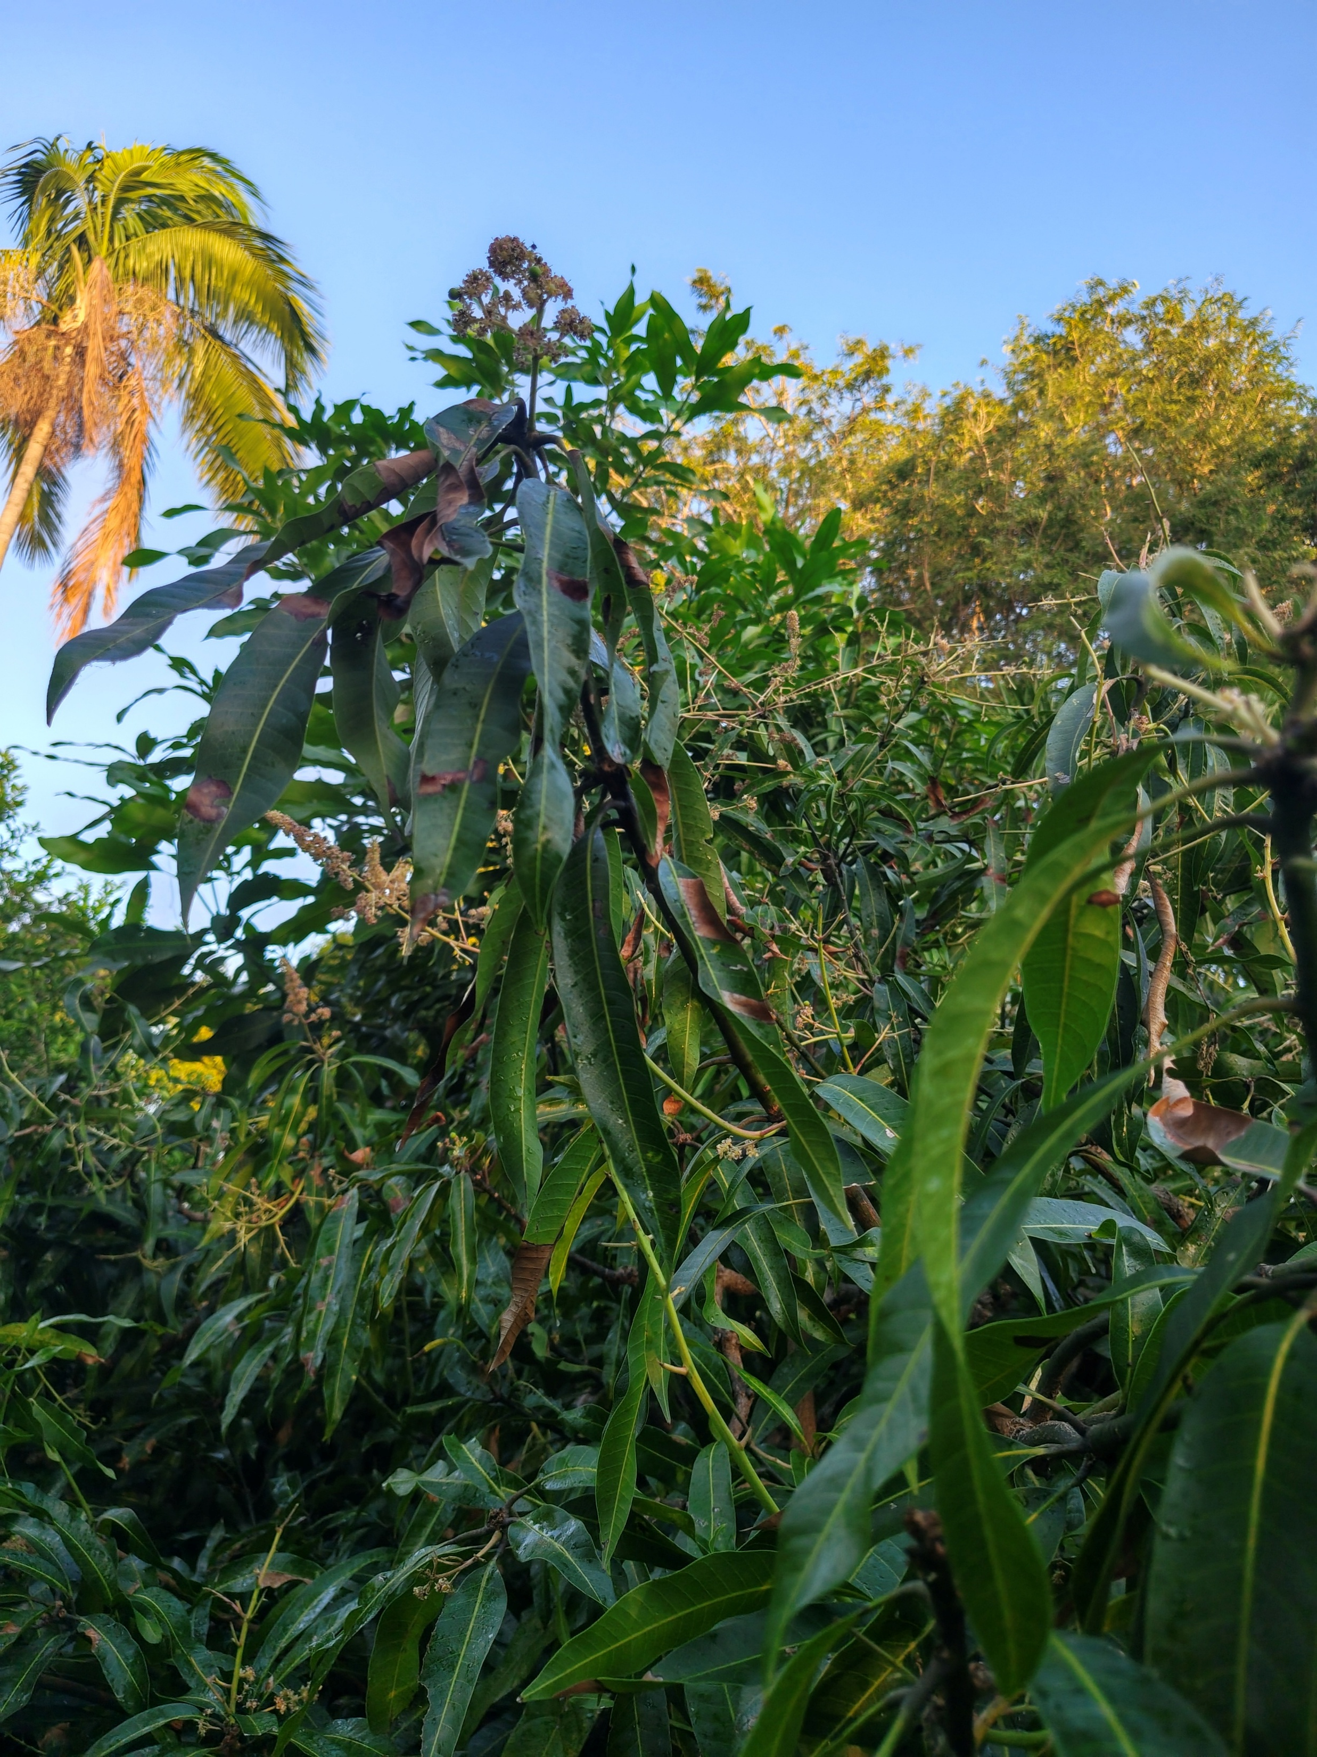
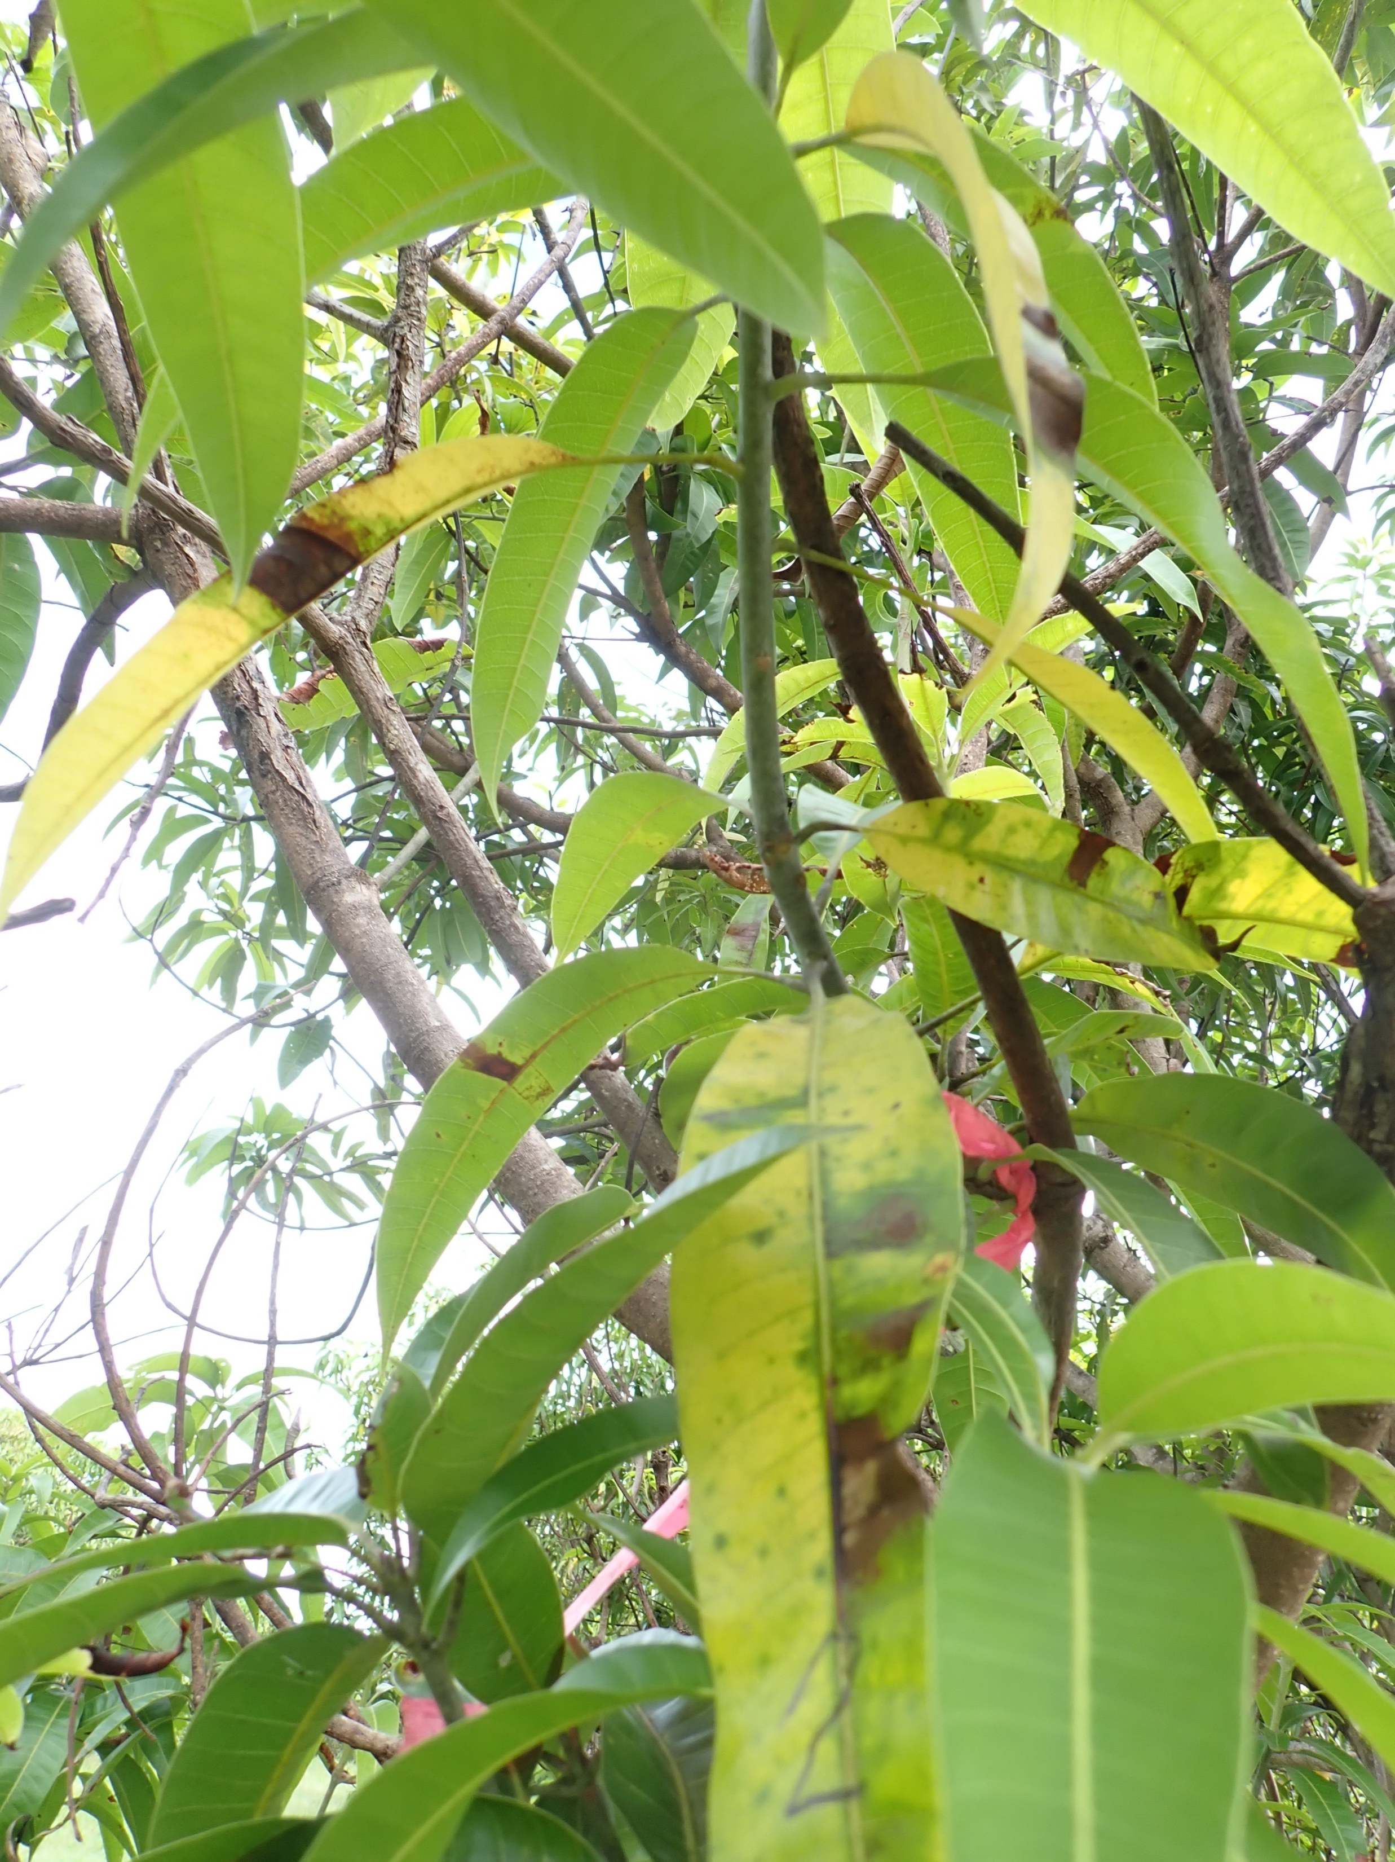
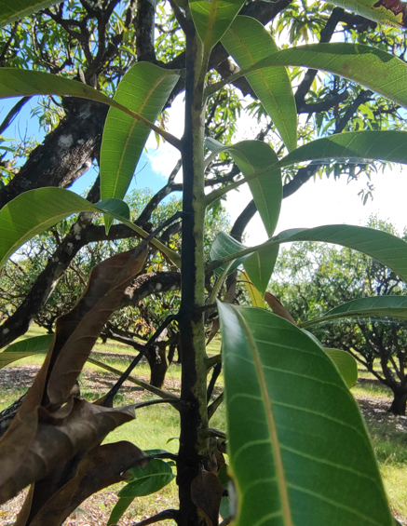
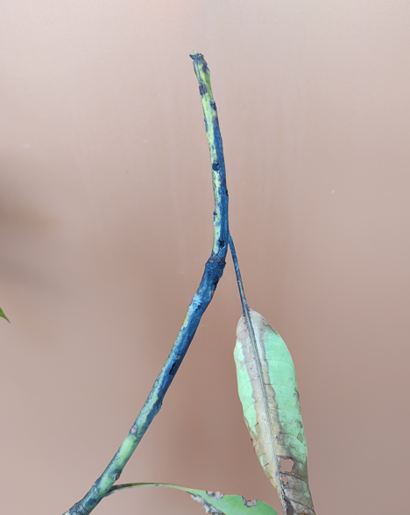
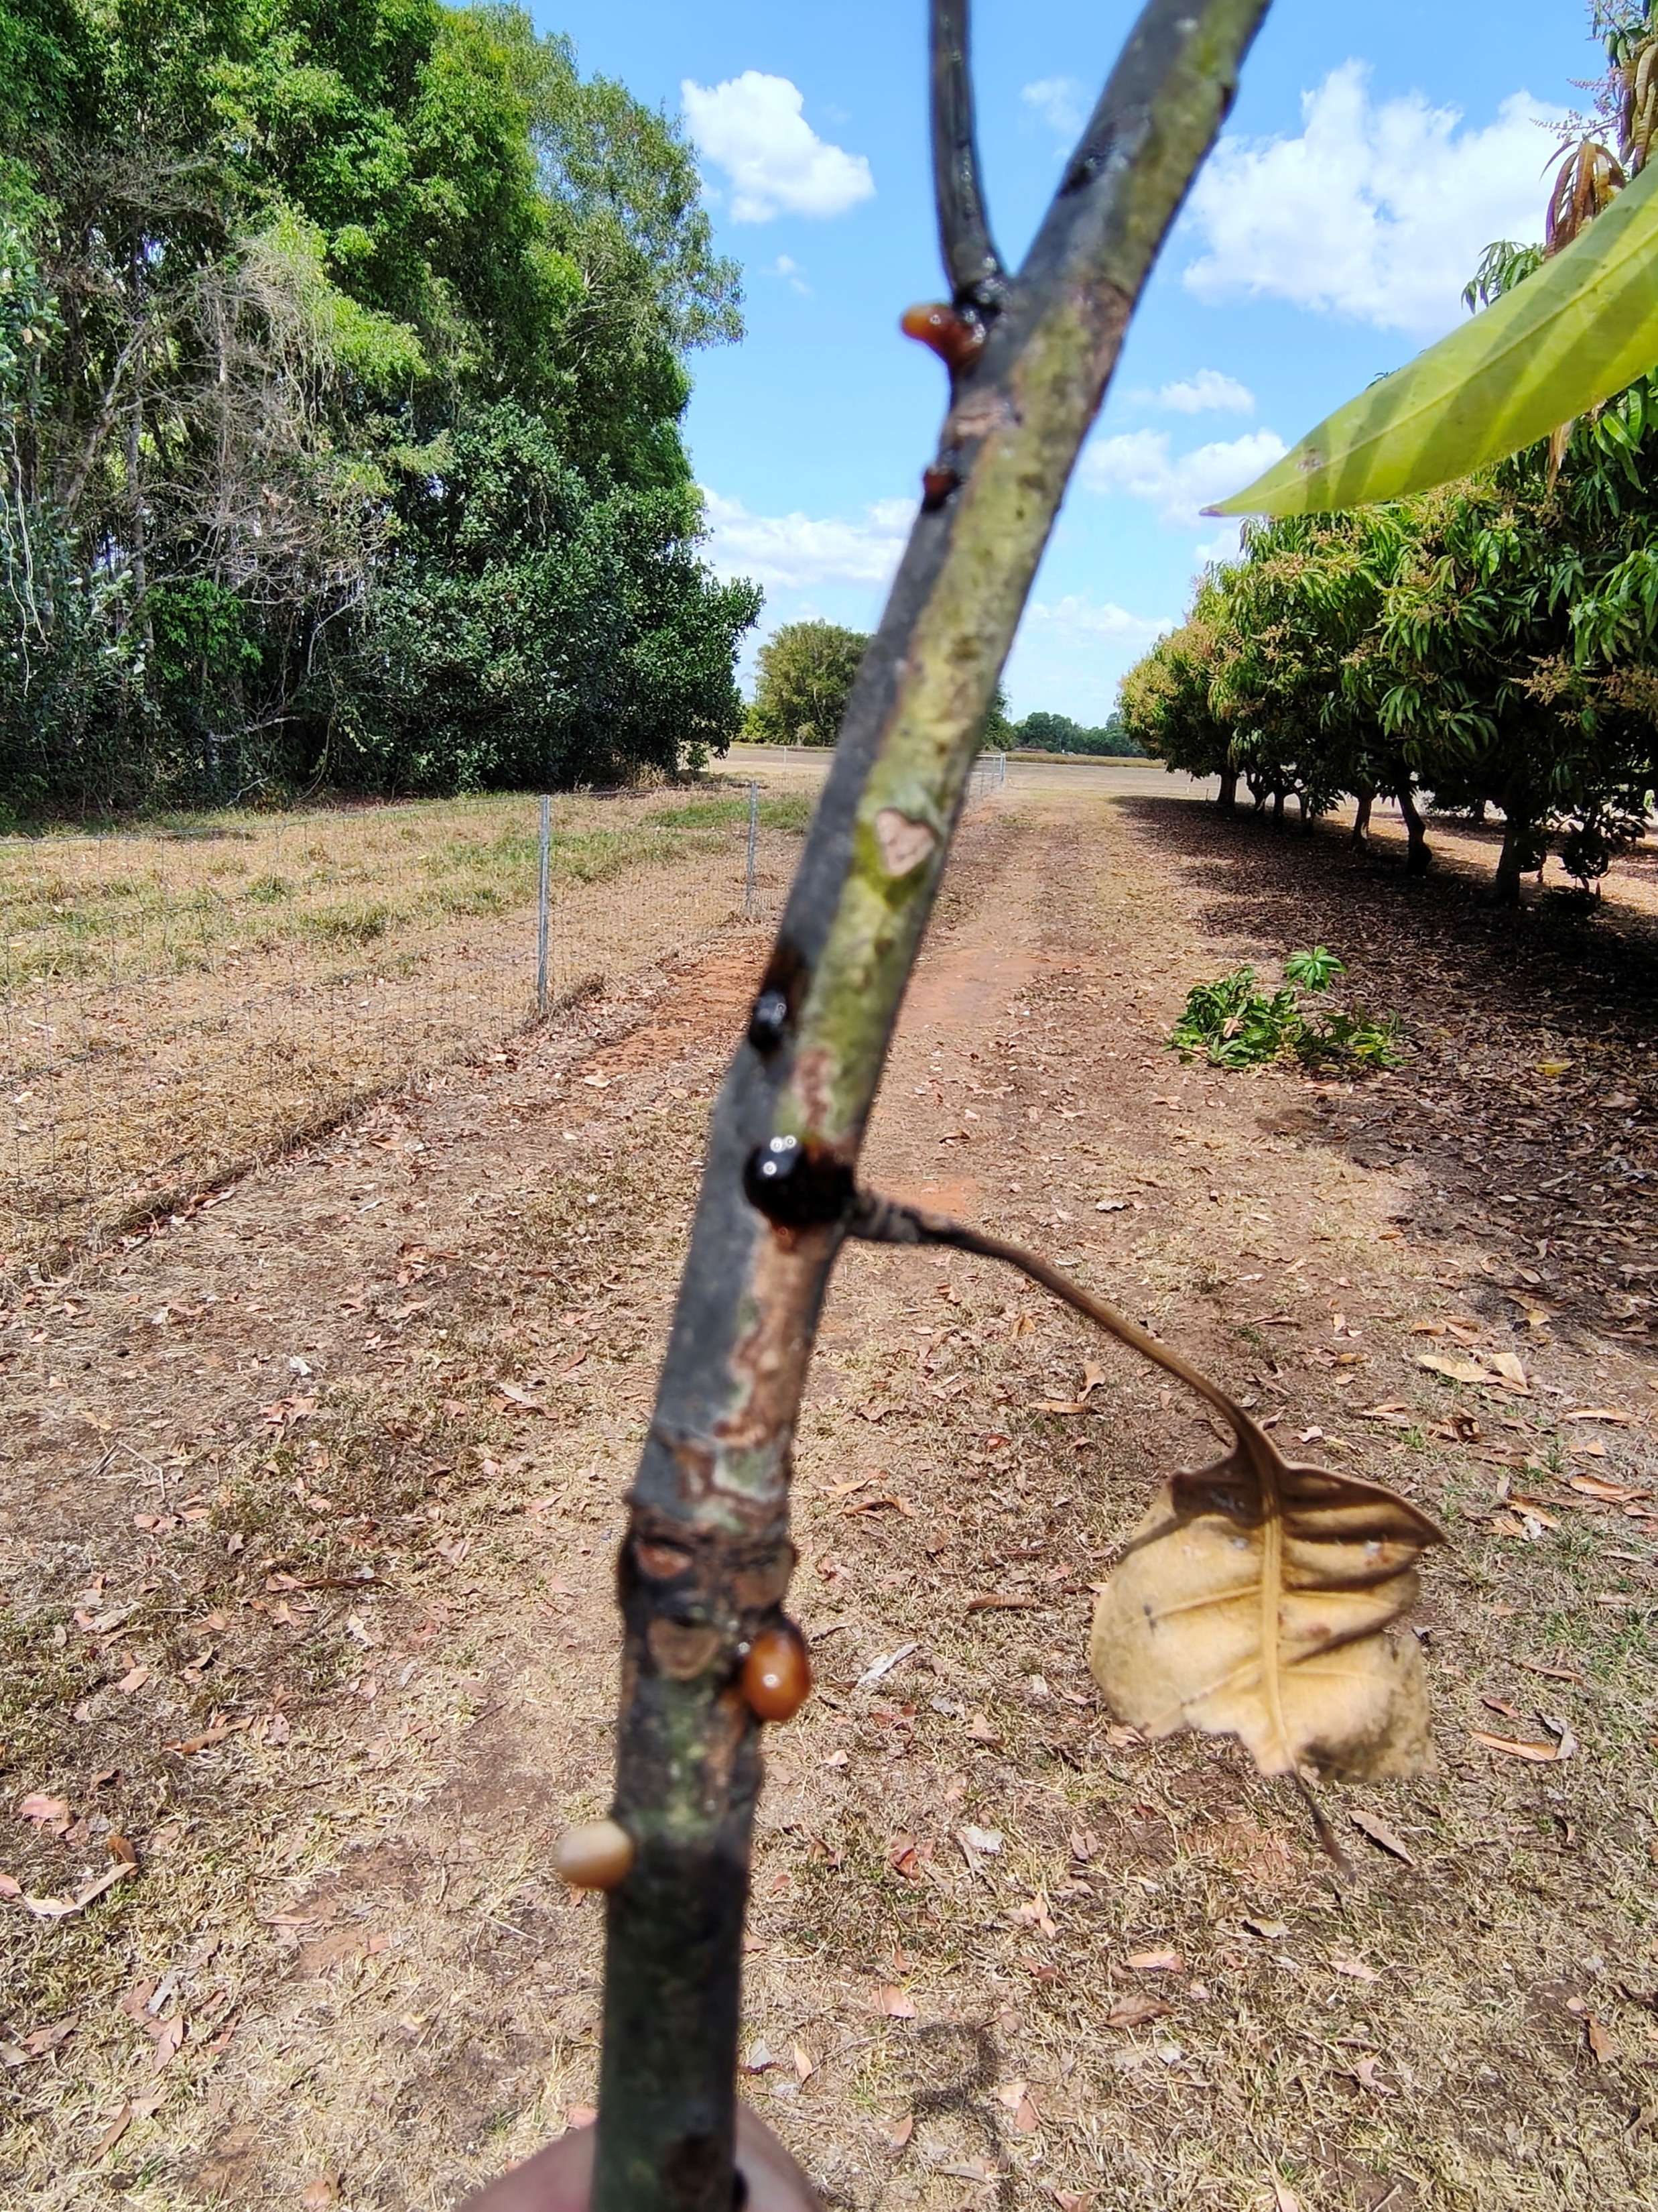
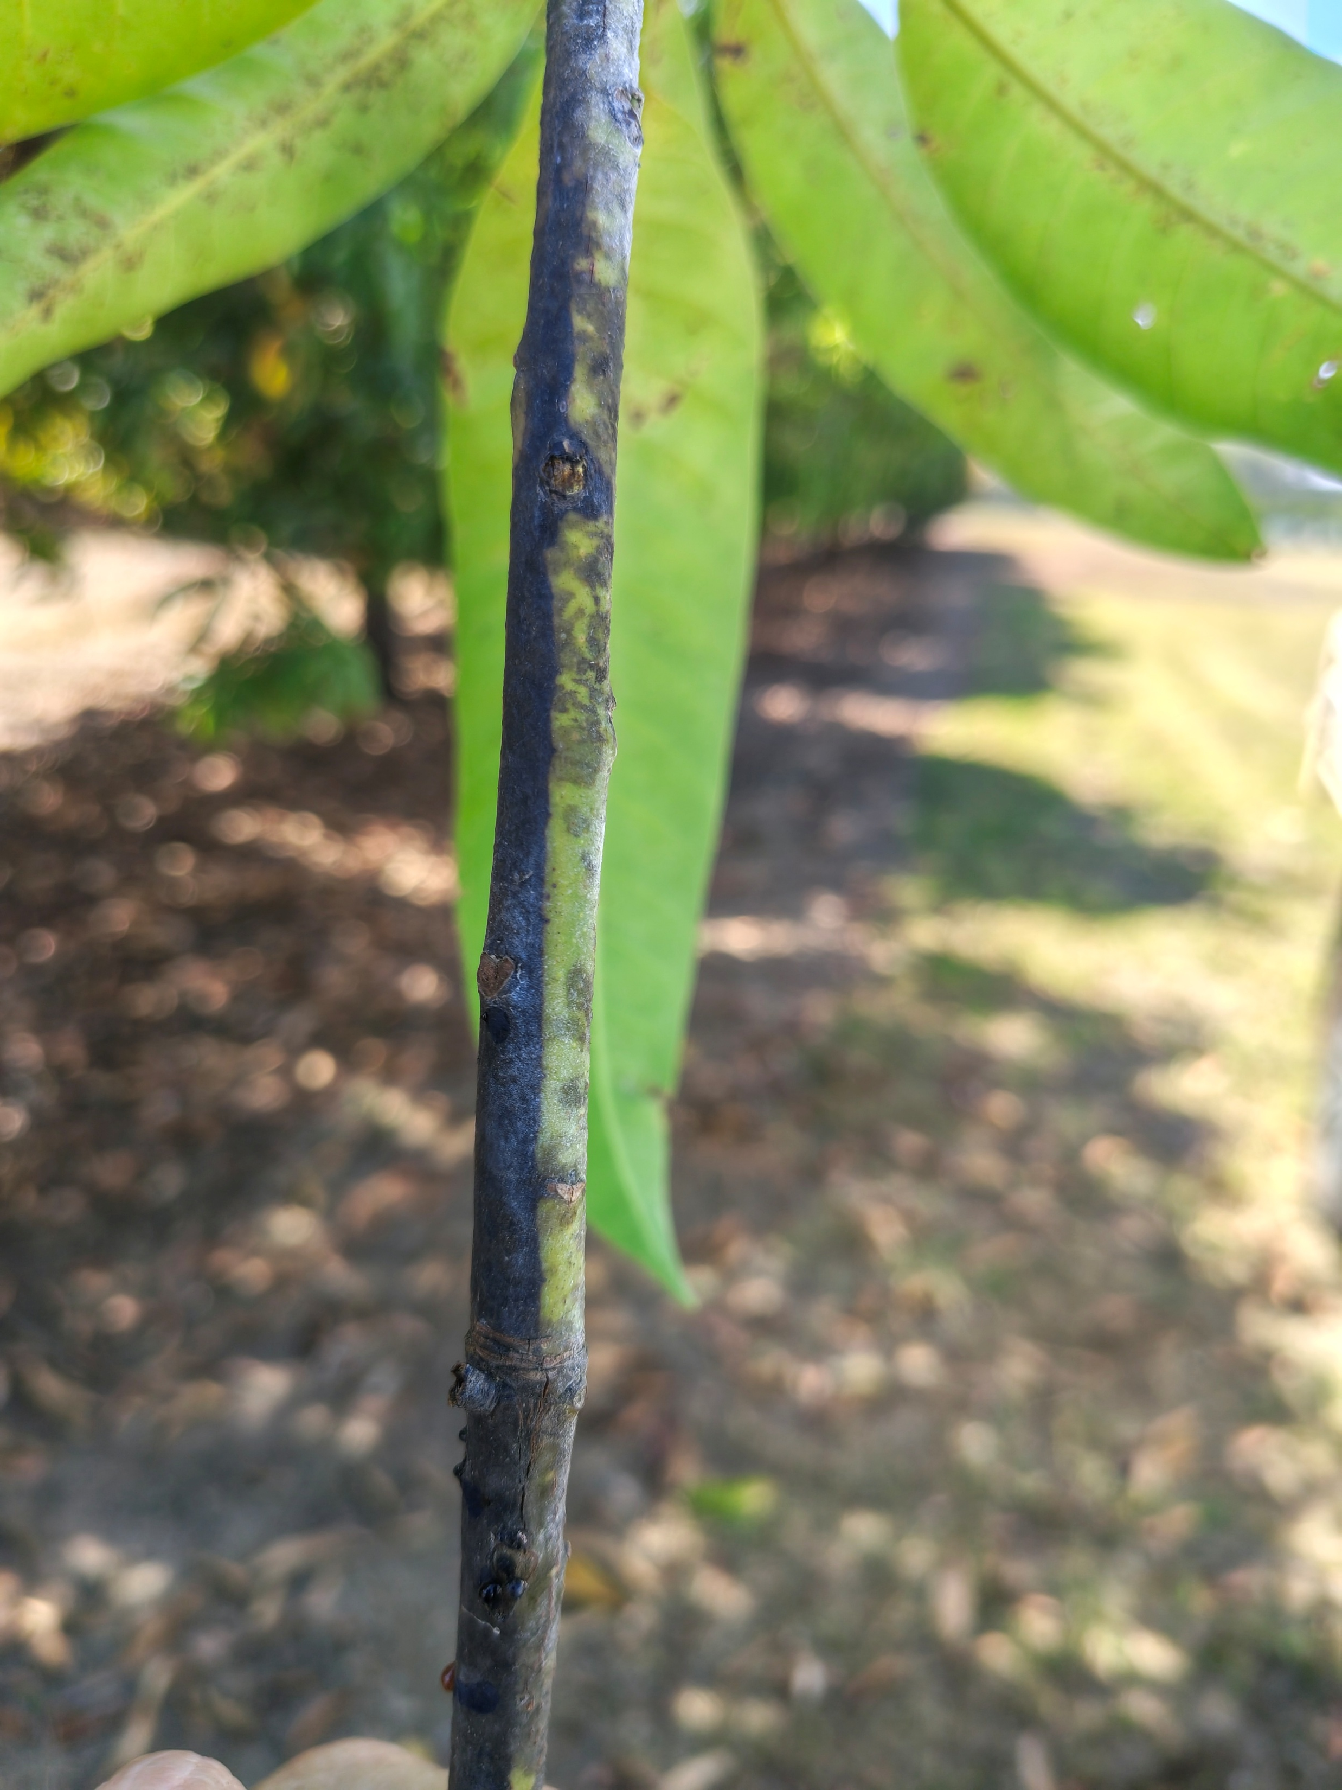
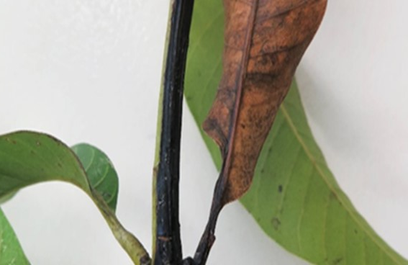
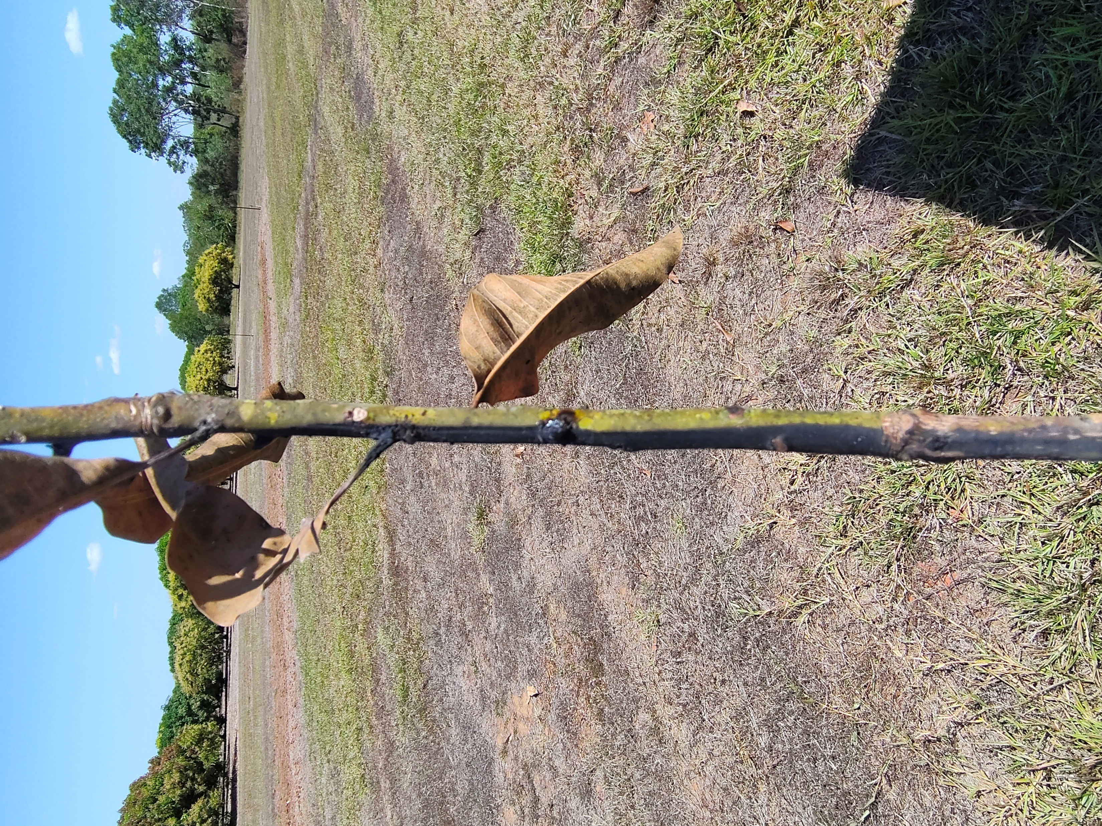

Field Identification of Mango Twig Tip Dieback (MTTD)
LOOK FOR THE SIGNS — THEN LOOK AT THE STEM
Single or multiple wilted (a), yellow (b), dessicated or dead leaves (c), leaf blight-necrotic leaf spots (d), gummosis (e) or terminal dieback (f) can all be supporting signs that MTTD may be present.
These symptoms should prompt a closer inspection of the associated twig.
The characteristic feature to look for is a DARK, UNILATERAL LESION running along ONE SIDE of the stem (g-j).
The unilateral stem lesion is what typifies MTTD.
Differing Features of MTTD and Common Dieback
Common dieback: Lesions tend to be circumferential, occur sporadically and remain largely confined to individual twigs in comparison to MTTD, which has greater propensity to spread to neighbouring twigs, resulting in repeated infections and progressive canopy loss.
These are field identification characteristics and do not replace laboratory confirmation of the disease or causal pathogen.
a
b
c
d
j
e
f
f
Further information:
https://daf.nt.gov.au/plants/research-and-development/horticulture/mangoes
Plant Industries,
NT Department of Agriculture and Fisheries Ph: 89992019
g
i
h

